Slide 1
Power BI to drive positive Customer Feedback
Gift wrap your reports for user experience
www.datalineo.com

Slide 2




At your Service!
Managing Director at Datalineo
Microsoft MVP Data Platform
Power BI, SQL/Azure/Power Platform
Events & User Group
Dublin Microsoft Fabric UG Leader
Data Ceili 13-14 June 2024
Ben Watt
@benrebooted
/benonline

Slide 3

Agenda
Branding & Navigation
Design
Visuals

Slide 4







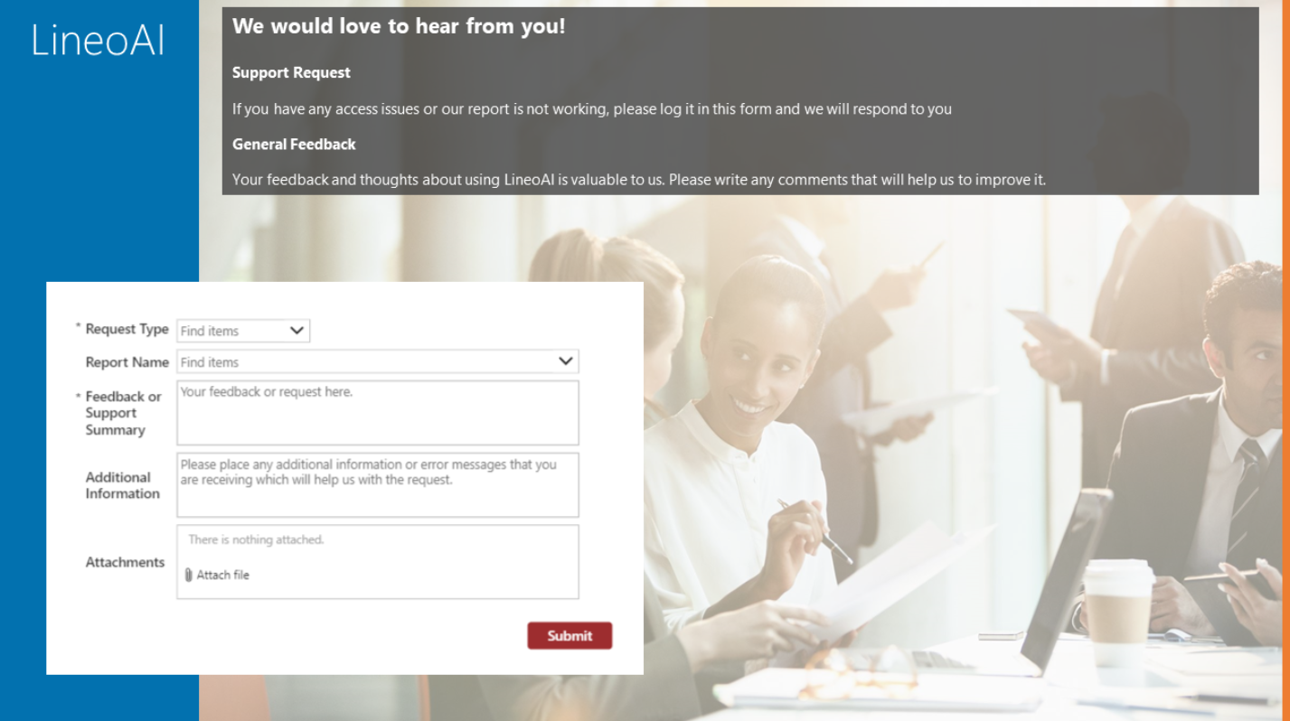
Navigation
Published App

Slide 5
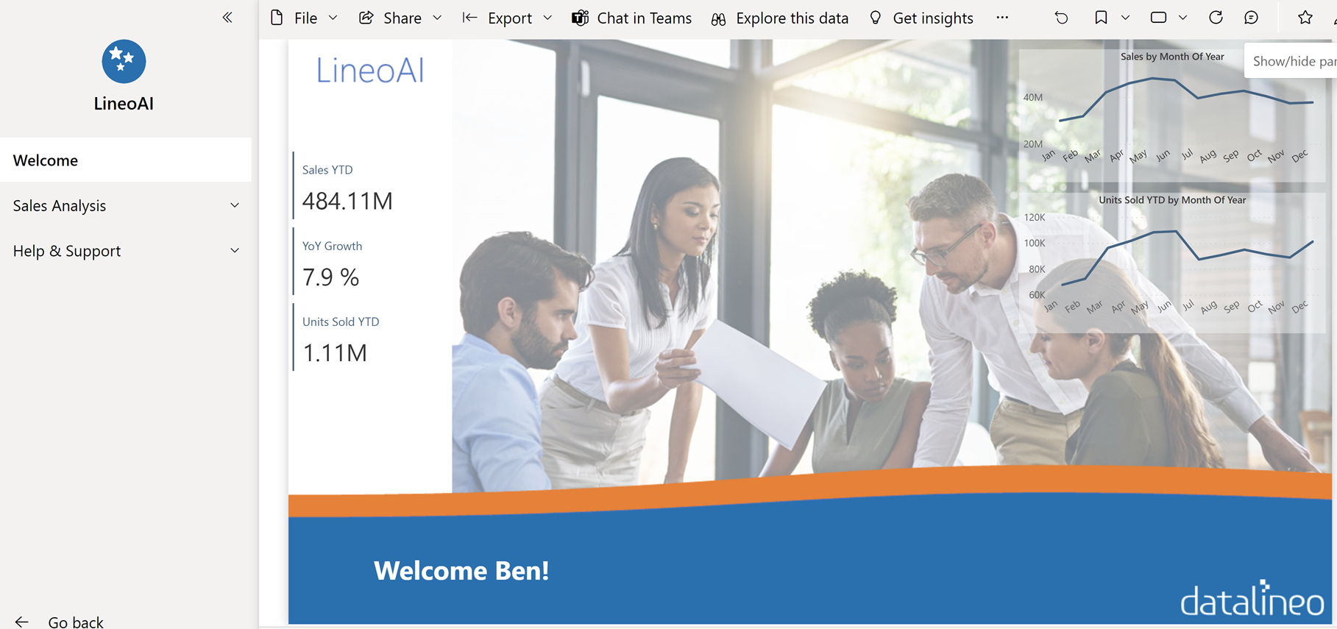

Branding & Navigation
Product Naming/Brand
Workspace utilisation
Developers & power users only
Published App
Consumer focused
Usage of audiences
Report Page
Landing page
Navigation bar

Slide 6
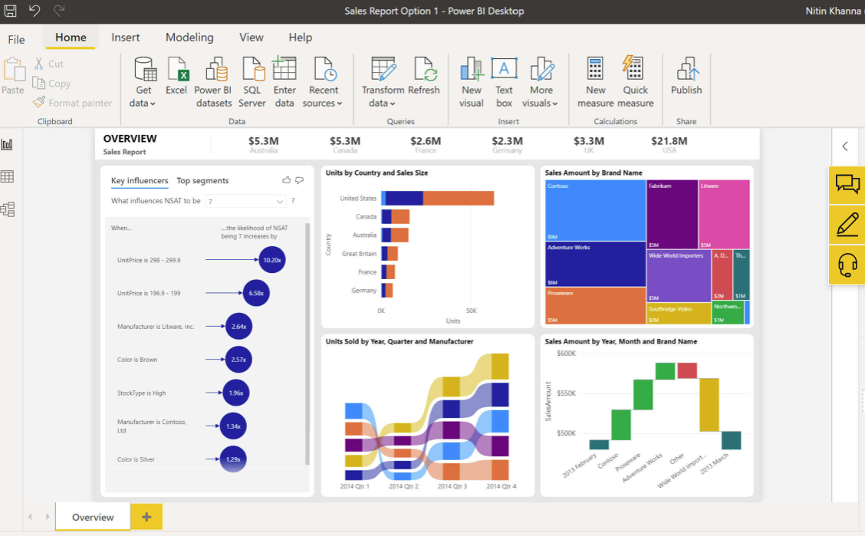
Design
Colours
Theme file
Non-branded visuals
Layout
Define arrangement standards
Don’t ask customer
Insights journey
Exec → Management → Operations → Exec
Drilldown/drill through
VOID

Slide 7
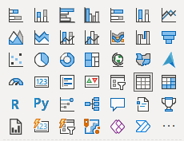
Visuals
Align to purpose & Insight
Fact
Trend
Outlier
Comparison
Spatial
Often
Line
Column/Bar
Card (new version)
Scatter
Sometimes
Pie Chart
Maps
Gauge
Waterfall
Never
Treemap
Key Influencer
Q&A
Funnel
Wildcard
Decomposition Tree
Metrics
Smart Narrative
Custom Visuals

Slide 8

Done.
@benrebooted
Demo content and slides here:
https://www.github.com/datalineo/sessions

